Slide 1
HTML5 API
by Yaroslav Vendysh

Slide 2
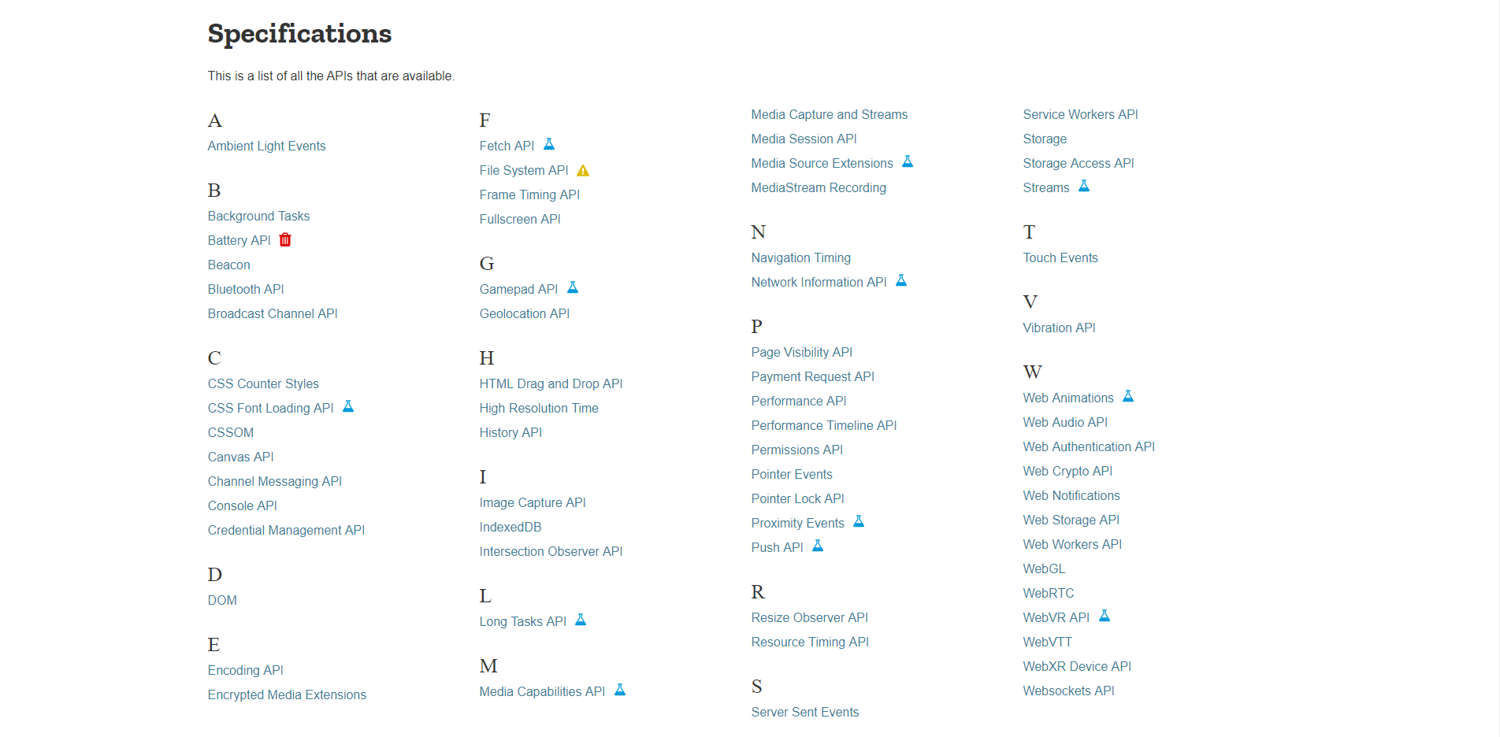
Full list of HTML5 APIs

Slide 3
HTML5 APIs - you might want to know
Page Visibility
Ambient Light
Online State
Vibration
Fullscreen
Battery
High Resolution Time

Slide 4
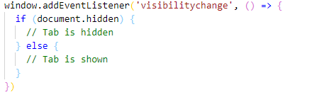
Page Visibility
Allows to know if the page is currently visible to the user by catching the following event:

Slide 5
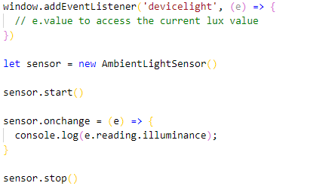
Ambient Light
Exposes data on the current level of lighting perceived by the user's sensors:

Slide 6
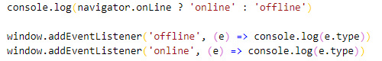
Online State
Tells us if the user is currently connected to a network:

Slide 7

Online State

Slide 8
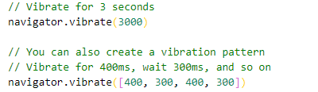
Vibration
Allows us to make the user's device vibrate:

Slide 9
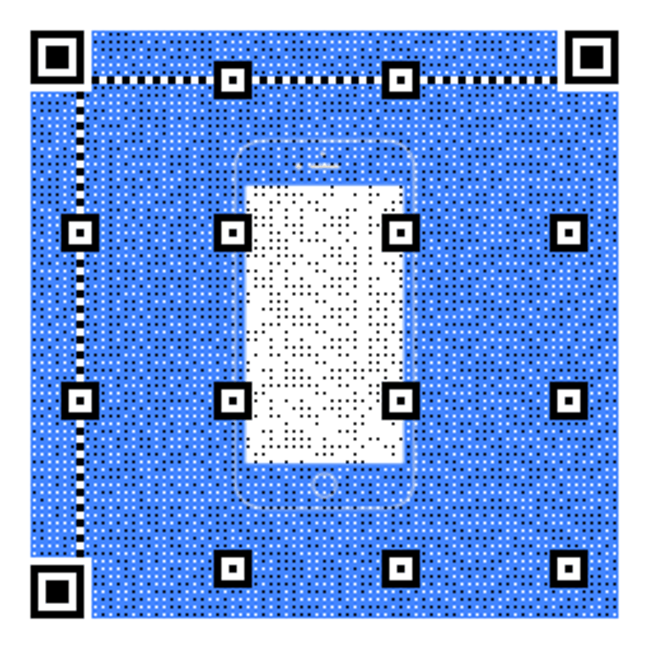
Vibration

Slide 10
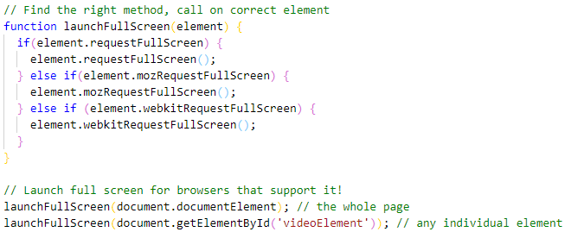
Fullscreen
Allows to programmatically launch the browser into full screen mode:

Slide 11
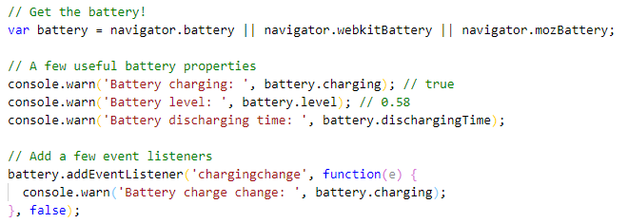
Battery
Mobile-targeted API providing insight into the device's battery level and status:

Slide 12
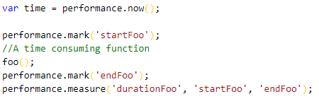
High Resolution Time
Provides the current time in sub-millisecond resolution:

Slide 13
HTML5 APIs - the most popular
Geolocation
Drag/Drop
Web Storage
Web Worker
Web Socket
SSE

Slide 14
Geolocation
The HTML Geolocation API is used to locate a user's position.
The HTML Geolocation API is used to get the geographical position of a user.
The position is not available unless the user approves it.

Slide 15
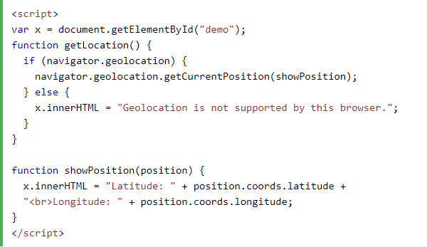
Geolocation

Slide 16
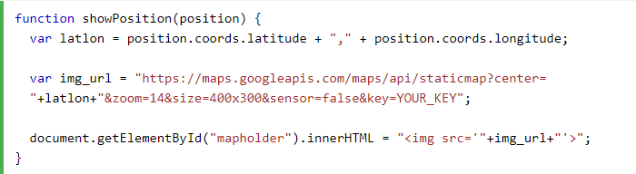
Geolocation

Slide 17
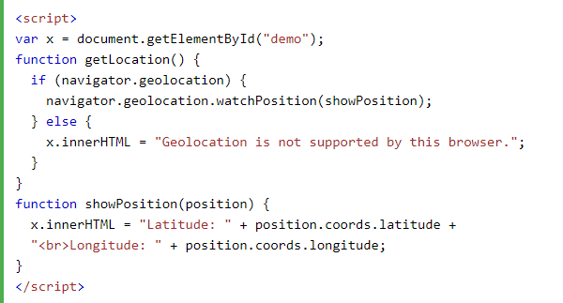
Geolocation

Slide 18
Drag/Drop
Drag and drop is a very common feature.
It is when you "grab" an object and drag it to a different location.
In HTML5, drag and drop is part of the standard: Any element can be draggable.

Slide 19
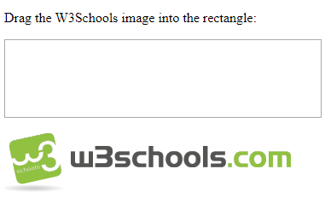
Drag/Drop

Slide 20
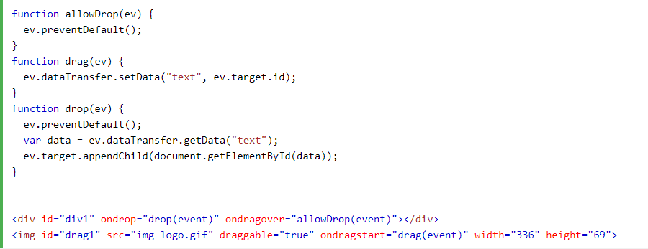
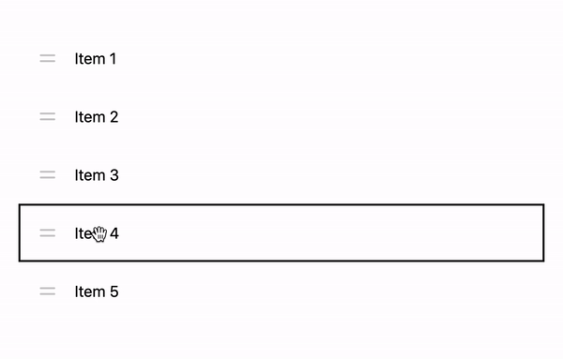
Drag/Drop

Slide 21
Drag/Drop

Slide 22
Web Storage
With web storage, web applications can store data locally within the user's browser.
Unlike cookies, the storage limit is far larger (at least 5MB).
Unlike cookies, information is never transferred to the server.
Web storage is per origin (per domain and protocol).
All pages, from one origin, can store and access the same data.

Slide 23
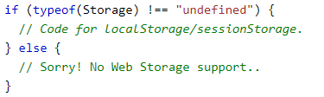
Web Storage
HTML web storage provides two objects for storing data on the client:
window.localStorage - stores data with no expiration date
window.sessionStorage - stores data for one session
Before using web storage, check browser support for localStorage and sessionStorage:

Slide 24
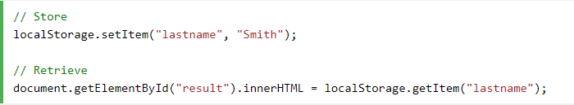
Web Storage
The localStorage object stores the data with no expiration date.
The data will not be deleted when the browser is closed, and will be available the next day.

Slide 25
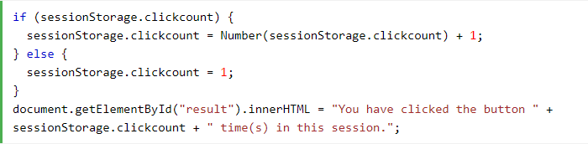
Web Storage
The sessionStorage object stores the data for only one session.
The data is deleted when the user closes the specific browser tab.

Slide 26
Web Storage
setItem(key, value) – store key/value pair.
getItem(key) – get the value by key.
removeItem(key) – remove the key with its value.
clear() – delete everything.
key(index) – get the key number index.
length – the number of stored items.
Use Object.keys to get all keys.
We access keys as object properties, in that case storage event isn’t triggered.

Slide 27
Web Worker
A JavaScript running in the background, without affecting the performance of the page.
You can continue to do whatever you want: clicking, selecting things.
Normally are not used for such simple scripts, but for more CPU intensive tasks.

Slide 28
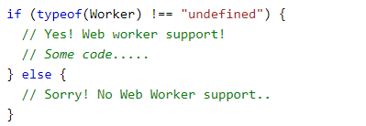
Web Worker
Before creating a web worker, check whether the user's browser supports it:

Slide 29
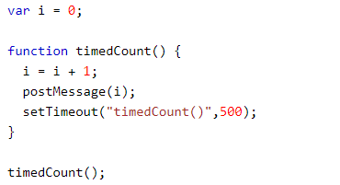
Web Worker
Now, let's create our web worker in an external JavaScript.
Here, we create a script that counts. The script is stored in the "demo_workers.js" file:

Slide 30
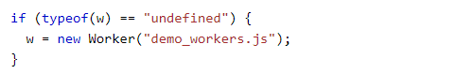
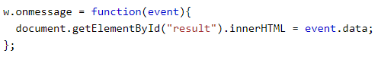
Web Worker
If the worker doesn’t exist - it creates a new web worker object and runs the code.
Then we can send and receive messages from the web worker:

Slide 31
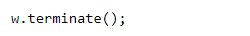
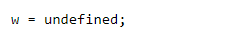
Web Worker
To terminate a web worker, and free browser/computer resources:
If you set the worker variable to undefined, after it has been terminated:

Slide 32
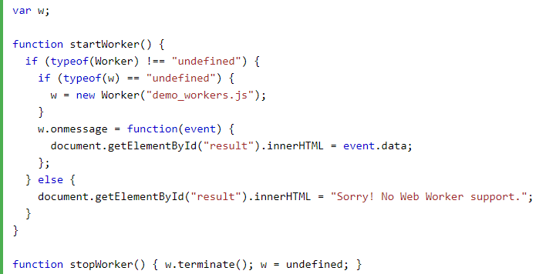
Web Worker

Slide 33
Server-Sent Events (SSE)
A server-sent event is when a web page automatically gets updates from a server.
It was possible before, but the web page would have to ask if updates were available.
With server-sent events, the updates come automatically.
Examples: Facebook/Twitter updates, stock price updates, news feeds, sport results, etc.

Slide 34
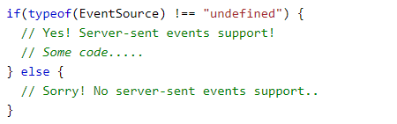
Server-Sent Events (SSE)
Before creating a server-sent event, check whether the user's browser supports it:

Slide 35
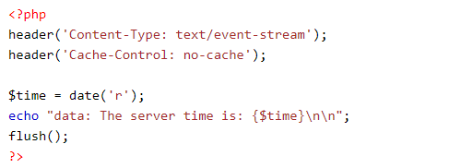
Server-Sent Events (SSE)
The server-side event stream syntax is simple.
For the example above to work, you need a server capable of sending data updates [PHP]:

Slide 36
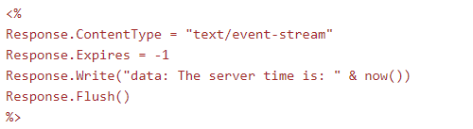
Server-Sent Events (SSE)
The server-side event stream syntax is simple.
For the example above to work, you need a server capable of sending data updates [VB]:

Slide 37
Web Socket
WebSocket provides a way to browser-server exchange data via a persistent connection.
The data can be passed in both directions as “packets”.
The data can be passed without breaking the connection and additional HTTP-requests.
WebSocket is especially great for services that require continuous data exchange.
Examples: online games, real-time trading systems and so on.

Slide 38
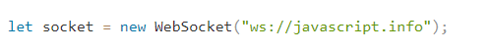
Web Socket
To open a websocket connection, we need to create new WebSocket using protocol ws:
There’s also encrypted wss:// protocol. It’s like HTTPS for websockets.

Slide 39
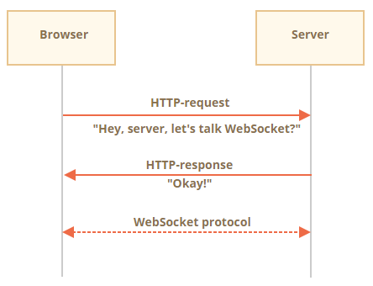
Web Socket

Slide 40
Web Socket
Once the socket is created, we should listen to events on it. There are totally 4 events:
open – connection established,
message – data received,
error – websocket error,
close – connection closed.

Slide 41
Web Socket
WebSocket communication consists of “frames” – data fragments, that can be of kinds:
text frames – contain text data that parties send to each other.
binary data frames – contain binary data that parties send to each other.
ping/pong frames – used to check the connection.
There’s also “connection close frame” and a few other service frames.

Slide 42
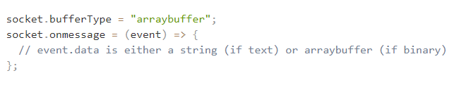
Web Socket
WebSocket .send() method can send either text or binary data.
When we receive the data, text always comes as string.
And for binary data, we can choose between Blob and ArrayBuffer formats.

Slide 43
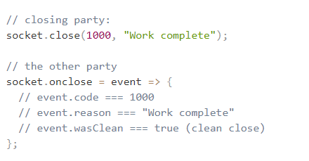
Web Socket
The method for close the connection (connection close frame) – .close():

Slide 44
Web Socket
To get connection state, additionally there’s socket.readyState property with values:
0 – “CONNECTING”: the connection has not yet been established.
1 – “OPEN”: communicating.
2 – “CLOSING”: the connection is closing.
3 – “CLOSED”: the connection is closed.

Slide 45
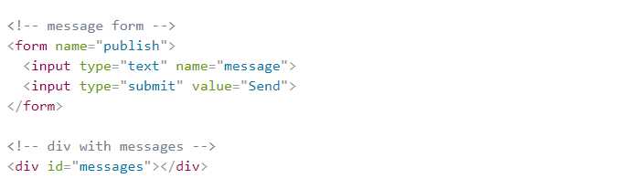
Web Socket – example chat (client)

Slide 46
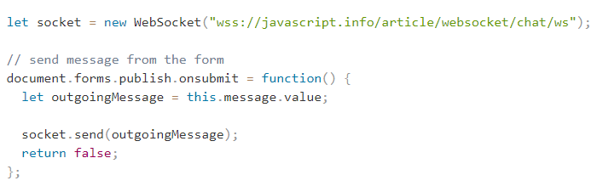
Web Socket – example chat (client)

Slide 47
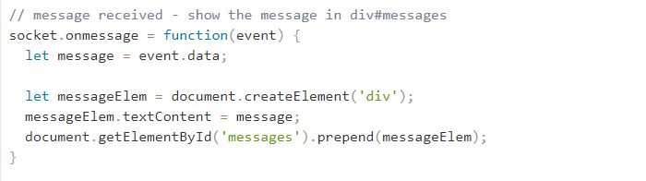
Web Socket – example chat (client)

Slide 48
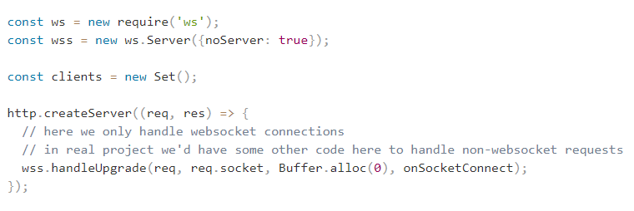
Web Socket – example chat (server)

Slide 49
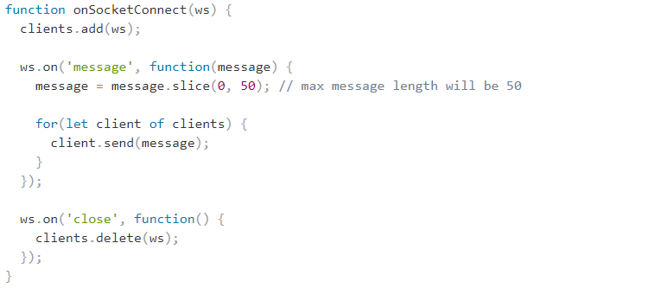
Web Socket – example chat (server)

Slide 50
Useful links
https://www.sitepoint.com/10-html5-apis-worth-looking/
https://dev.to/christopherkade/html5-web-apis-you-might-want-to-know-4cbm
http://html5index.org/
https://www.w3schools.com/html/html5_geolocation.asp
https://www.w3schools.com/html/html5_draganddrop.asp
https://www.w3schools.com/html/html5_webstorage.asp
https://www.w3schools.com/html/html5_webworkers.asp
https://www.w3schools.com/html/html5_serversentevents.asp

Slide 51
Thank you for attention
by Yaroslav Vendysh

